Slide 1
Marketing Analytics
Session 3
Segmentation

Slide 2
Agenda
Segmentation
An overview
Descriptive segmentation
Hierarchical (cluster)
Non-hierarchical (k-means)
Predictive segmentation
CART
Ad hoc segmentation
Segmentation in practice
A complete example

Slide 3
segmentation
An overview

Slide 4
Segmentation
Segmentation is the process of categorizing customers into groups (a.k.a. segments, clusters)
…Such that customers within a segment are similar enough to be treated similarly, yet different enough from customers in other segments

Slide 5
A good segment is…
Distinct from the other segments
Homogeneous
Identifiable
Substantial
Significant enough that it's worth creating/using it?
Useful, operational, and informative
What can I learn from it?
How can it help my marketing strategy?

Slide 6
Example of segmentation variables
Recency
Date of last purchase
Frequency
How many purchases made
1 = new customer
2+ = repeat customer
Monetary
Average purchase amount
Total, maximum, median, etc.
Type
Type of purchase, of customer, etc.
Length of relationship
Time since first purchase
Value percentiles (e.g., top 20%)
Etc.
RFM
FRAT

Slide 7
Extract basic marketing indicators
# We will focus on regular donations only...
SELECT contact_id,
MAX(act_date) AS 'recency',
COUNT(amount) AS 'frequency',
AVG(amount) AS 'avgamount',
MIN(act_date) AS 'firstdonation'
FROM acts
WHERE act_type_id = 'DO'
GROUP BY 1
ORDER BY 1;

Slide 8
Extract basic marketing indicators
# We will focus on regular donations only...
# Express a date as duration since ..., in years
# The database stops at June 25th, 2018
ELECT contact_id,
DATEDIFF(20180625, MAX(act_date)) / 365
AS 'recency',
COUNT(amount) AS 'frequency',
AVG(amount) AS 'avgamount',
DATEDIFF(20180625, MIN(act_date)) / 365
AS 'firstdonation'
FROM acts
WHERE act_type_id = 'DO'
GROUP BY 1;

Slide 9
Descriptive segmentation
Individuals are grouped based on their similarities
The algorithms are automatic
Maximize heterogeneity across segments
Maximize homogeneity within segments
Major approach #1: hierarchical clustering
Variants: distance metric
Major approach #2: k-means

Slide 10
hierarchical clustering
Descriptive segmentation

Slide 11
Example
Segment respondents based on 2 segmentation variables

Slide 12
Example
How many segments of customers do you see?

Slide 13
Example
Intuitively, customers can be segmented into three segments with homogeneous needs
Segment 1
Segment 2
Segment 3

Slide 14
Hierarchical clustering step by step
How to reach that result more formally?
At first, consider each customer as a separate segment
Find the two segments/customers that, if grouped together, would lead to the lowest loss of information
Continue merging segments/customers until such merging would lead to an unacceptable loss of information

Slide 15
Hierarchical clustering step by step
We start with 8 segments. Which should be grouped first?

Slide 16
Hierarchical clustering step by step
Which should be grouped next?

Slide 17
Hierarchical clustering step by step
Which should be grouped next?

Slide 18
Hierarchical clustering step by step
Which should be grouped next?

Slide 19
Hierarchical clustering step by step
Which should be grouped next?

Slide 20
Hierarchical clustering step by step
Which should be grouped next?

Slide 21
Hierarchical clustering step by step
Which should be grouped next?

Slide 22
Hierarchical clustering step by step
You can segment your customers into… One segment (not very useful, though)

Slide 23
A more systematic approach
Real-life applications will be much more complex:
Many more dimensions
Many more individuals
How to treat larger datasets?
A more formal definition of “similarity”? Euclidean distance
A more formal definition of “loss of information”? Dendrogram

Slide 24
Formal definition for “similarity”
We define “similarity” as the Euclidean distance between
the variables of two individuals
d_{ab} is the dissimilarity between respondents a and b
The greater the distance, the smaller the similarity
x_{a} and x_{b} are the value of their variables “x”
The formula can deal with as many dimensions as needed
Dimensions need to be scaled (standardized)

Slide 25
Hierarchical clustering with R
# Load the package
library(RODBC)
# Connect to MySQL (my credentials are mysql_server_64/root/-
db = odbcConnect("mysql_server_64", uid="root", pwd="")
sqlQuery(db, "USE ma_charity_small")
# Get key data (for a random sample of 2,000 contacts)
query = "SELECT contact_id,
DATEDIFF(20180625, MAX(act_date)) / 365 AS 'recency',
COUNT(amount) AS 'frequency',
AVG(amount) AS 'avgamount',
DATEDIFF(20180625, MIN(act_date)) / 365 AS 'firstdonation'
FROM acts
WHERE act_type_id = 'DO'
GROUP BY 1
ORDER BY RAND()
LIMIT 2000"
data = sqlQuery(db, query)
# Close the connection
odbcClose(db)
Hierarchical clustering involves a N² process. Extremely slow on large data sets.
We'll apply it on 2000 random contacts only.

Slide 26
Hierarchical clustering with R (cont'd)
# Assign contact id as row names, remove id from data
rownames(data) = data$contact_id
data = data[, -1]
# Compute distance metrics on standardized data
d = dist(scale(data))
# Perform hierarchical clustering on distance metrics
c = hclust(d, method="ward.D2")
# Plot de dendogram
plot(c)

Slide 27
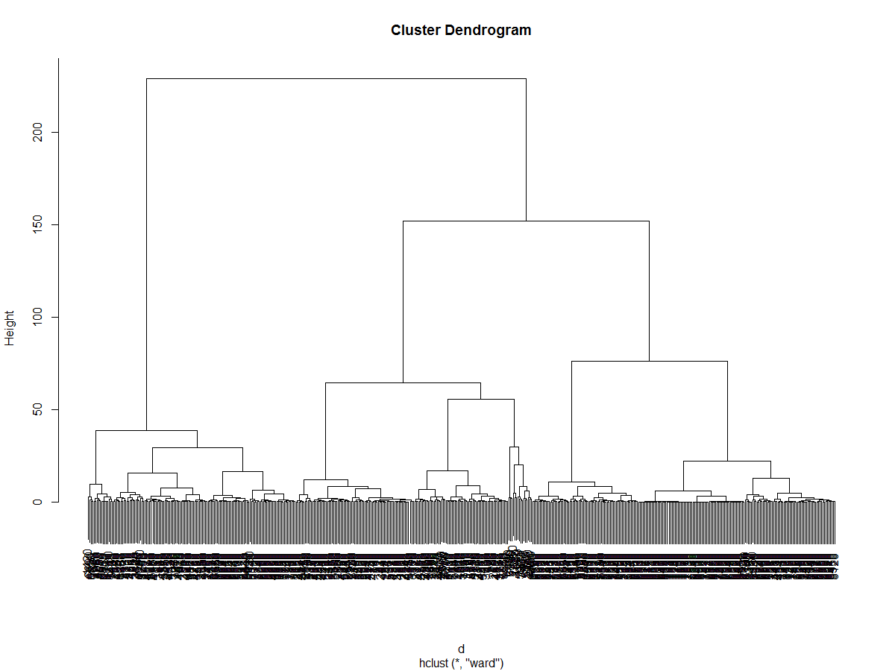
Dendogram
The dendogram shows how much distance separates the next two closest segments
The value on the y-axis indicates how much distance we need to travel to join two segments
i.e., how much information is lost when two segments are grouped together

Slide 28
Dendogram
The dendogram shows how much distance separates the next two closest segments
If there is a "sudden jump", stop
Here, maybe 3 segments?

Slide 29
Hierarchical clustering with R (cont'd)
# Cut at 5 segments
members = cutree(c, k=5)
# Show 50 first donors, frequency table
print(members[1:50])
print(table(members))
# Show profile of each segment
for (i in 1:5) {
print(colMeans(data[members == i, ]))
}

Slide 30
K-MEANS
Descriptive segmentation

Slide 31
K-means
Decide number of segments (N) a priori
Pick N segment centroids randomly
Centroid = average of all segmentation variables
Usually picked among individuals to segment, so it ensures it starts from an interior solution, and no empty segment
Assign each individual to the closest segment centroid
Compute again segment centroids
Repeat steps 3 and 4 till no change is observed

Slide 32
K-means
GENEROSITY
LOYALTY

Slide 33
K-means – step 1 & 2
GENEROSITY
LOYALTY

Slide 34
K-means – step 3
GENEROSITY
LOYALTY

Slide 35
K-means – step 4
GENEROSITY
LOYALTY

Slide 36
K-means – step 3
GENEROSITY
LOYALTY

Slide 37
K-means – step 4
GENEROSITY
LOYALTY

Slide 38
K-means – step 3
GENEROSITY
LOYALTY

Slide 39
K-means – etc.
GENEROSITY
LOYALTY

Slide 40
Issues with k-means
How many segments ? 3, 4, 5 ?
Try multiple solutions and see which is "best"
Silhouette analysis
Stuck in local solution?
Start from different starting solutions
Automatically keep "the best"

Slide 41
Issues with k-means
How many segments ? 3, 4, 5 ?
Try multiple solutions and see which is "best"
Silhouette analysis
Stuck in local solution?
Start from different starting solutions
Automatically keep "the best"

Slide 42
Issues with k-means
How many segments ? 3, 4, 5 ?
Try multiple solutions and see which is "best"
Silhouette analysis
Stuck in local solution?
Start from different starting solutions
Automatically keep "the best"

Slide 43
Basic k-means with R
# Load the package
library(RODBC)
# Connect to MySQL (use your credentials)
db = odbcConnect("mysql_server_64", uid="root", pwd="")
sqlQuery(db, "USE ma_charity_small")
# Extract data from database
query = "SELECT contact_id,
DATEDIFF(20180625, MAX(act_date)) / 365 AS 'recency',
COUNT(amount) AS 'frequency',
AVG(amount) AS 'avgamount',
DATEDIFF(20180625, MIN(act_date)) / 365 AS 'firstdonation'
FROM acts
WHERE act_type_id = 'DO'
GROUP BY 1"
data = sqlQuery(db, query)
# Close the connection
odbcClose(db)

Slide 44
Basic k-means with R (cont'd)
# Assign contact id as row names, remove id from data
rownames(data) = data$contact_id
data = data[, -1]
# Perform segmentation on standardized data
k = kmeans(x = scale(data), centers = 5, nstart = 50)
# Print cluster size, standardized centers, and
# un-standardized centers, one segment at a time
print(k$size)
print(k$centers)
for (i in 1:5) {
print(colMeans(data[k$cluster == i, ]))
}

Slide 45
CART
Predictive segmentation

Slide 46
CART
CART = Classification And Regression Tree
Create a model that predicts the value of a target variable
Purchase
Loyalty
Brand choice
Etc.
In the process of applying sequential classifications, a "tree" will grow, and individuals with similar target variable will fall into the same "leaf nodes" (segments)

Slide 47
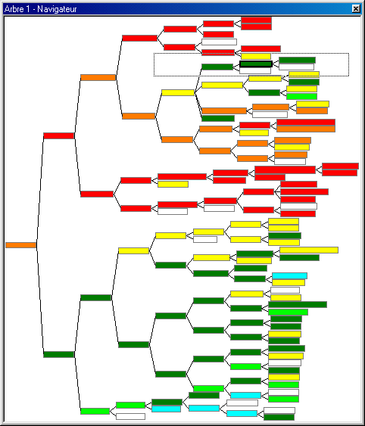
CART

Slide 48
CART in practice
1. Select the predictors (segmentation variables)
Recency, Frequency, Amount, Demographics, etc.
2. Select the target variable, to be predicted/explained
Buy or not, Donate or not (0/1)
Brand choice (A, B, C)
Purchase amount ($X)
3. Group all individuals into a “parent node”
For each available predictor, one by one, split the population (the parent node) into subgroups (the child nodes), and check to what extent the child nodes are
More homogeneous (within)
More distinct (between)

Slide 49
CART in practice
5. Keep the split that works best
Where “best” is usually measured by a statistical index, such as entropy, Gini index, RMSE, etc.
Repeat for each child node
Stop when some criteria are met
No further improvement,
Not enough data to keep going
8. Prune the tree back to avoid overfitting

Slide 50
Extract data for a CART model
# Step 1: check whose donors have made a donation
# within the last 12 months (our target variable)
SELECT contact_id, COUNT(amount) AS counter
FROM acts
WHERE (act_date >= 20170625) AND
(act_date < 20180625) AND
(act_type_id = 'DO')
GROUP BY contact_id;

Slide 51
Extract data for a CART model
# Merge predictors and target variable into one big query
# Predictors need to precede the target variable in time !!!
SELECT a.contact_id,
DATEDIFF(20170625, MAX(a.act_date)) / 365 AS 'recency',
COUNT(a.amount) AS 'frequency',
AVG(a.amount) AS 'avgamount',
DATEDIFF(20170625, MIN(a.act_date)) / 365 AS 'firstdonation',
IF(c.counter IS NULL, 0, 1) AS 'loyal'
FROM acts a
LEFT JOIN (SELECT contact_id, COUNT(amount) AS counter
FROM acts
WHERE (act_date >= 20170625) AND
(act_date < 20180625) AND
(act_type_id = 'DO')
GROUP BY contact_id) AS c
ON c.contact_id = a.contact_id
WHERE (act_type_id = 'DO') AND (act_date < 20170625)
GROUP BY 1"

Slide 52
CART in R…
# Load the package
library(RODBC)
# Connect to MySQL (use your own credentials)
db = odbcConnect("mysql_server_64", uid="root", pwd="")
sqlQuery(db, "USE ma_charity_small")
# Extract data from database
query = "SELECT a.contact_id,
DATEDIFF(20170625, MAX(a.act_date)) / 365 AS 'recency',
COUNT(a.amount) AS 'frequency',
AVG(a.amount) AS 'avgamount',
DATEDIFF(20170625, MIN(a.act_date)) / 365 AS 'firstdonation',
IF(c.counter IS NULL, 0, 1) AS 'loyal'
FROM acts a
LEFT JOIN (SELECT contact_id, COUNT(amount) AS counter
FROM acts
WHERE (act_date >= 20170625) AND
(act_date < 20180625) AND
(act_type_id = 'DO')
GROUP BY contact_id) AS c
ON c.contact_id = a.contact_id
WHERE (act_type_id = 'DO') AND (act_date < 20170625)
GROUP BY 1"
data = sqlQuery(db, query)
# Close the connection
odbcClose(db)

Slide 53
CART in R… (cont'd)
# Assign contact id as row names, remove id from data
rownames(data) = data$contact_id
data = data[, -1]
# Load the library that contains the classification tree
# procedure. Don't forget to install the libraries first
library(rpart)
library(rpart.plot)
# Create a decision tree model
tree = rpart(formula = loyal ~ ., data = data, cp=.02)
# Print splits
print(tree)
# Visualize the decision tree with rpart.plot
rpart.plot(tree, box.palette = "RdBu", shadow.col = "gray",
nn = TRUE)

Slide 54
ad hoc segmentation

Slide 55
Segmentation in practice
Segmentation is used by everybody
Needs to remain simple
Marketing strategy is built on segmentation
Segmentation needs to remain stable over time
Segmentation is updated regularly
Counter-productive to involve analyst every time
Needs to be automated within the database
Customers switch segment
Where do they come from? Where do they go?
Need to track segment memberships over multiple periods

Slide 56
Our objectives
Build a segmentation scheme from within MySQL
Keep track of segment membership over multiple periods
"One click" update

Slide 57
A (very) simple segmentation
Segmentation variables : recency, automatic deduction, first donation, and generosity
36+ MONTHS
25-36 MONTHS
13-24 MONTHS
0-12 MONTHS
LOST
COLD
WARM
AUTO
TOP
(≥ 100 EUR)
BOTTOM
(< 100 EUR)
NEW

Slide 58
Create a "periods" table
# We're going to divide the past in periods
# Create a table to store period information
CREATE TABLE periods (
period_id INTEGER NOT NULL,
first_day DATE NOT NULL,
last_day DATE NOT NULL,
PRIMARY KEY (period_id)
)ENGINE = MyISAM;

Slide 59
Populate the periods table
# Define 11 periods
# Period 0 = the most recent ("today")
INSERT INTO periods
VALUES ( 0, 20170626, 20180625),
( 1, 20160626, 20170625),
( 2, 20150626, 20160625),
( 3, 20140626, 20150625),
( 4, 20130626, 20140625),
( 5, 20120626, 20130625),
( 6, 20110626, 20120625),
( 7, 20100626, 20110625),
( 8, 20090626, 20100625),
( 9, 20080626, 20090625),
(10, 20070626, 20080625);

Slide 60
Create a "segment" table
# Create a segment table
# It will store to which segment each donor belonged
# in each period
CREATE TABLE segments (
sq INTEGER UNSIGNED NOT NULL AUTO_INCREMENT,
contact_id INTEGER UNSIGNED NOT NULL,
period_id INTEGER NOT NULL,
segment VARCHAR(6),
PRIMARY KEY (sq),
INDEX idx_contact_id(contact_id),
INDEX idx_period_id(period_id))
ENGINE = MyISAM;

Slide 61
Create placeholders in the segment table
# This will create a placeholder for all
# contact-by-period possible combinations
# (not really optimal, but this will do...)
INSERT INTO segments (contact_id, period_id)
SELECT a.contact_id, p.period_id
FROM acts a,
periods p
GROUP BY 1, 2;

Slide 62
Create the "AUTO" segment
# Step 1: which donors are under automatic deduction,
# and during which periods?
SELECT contact_id, period_id
FROM acts a, periods p
WHERE (a.act_date <= p.last_day) AND
(a.act_date >= p.first_day) AND
(a.act_type_id LIKE 'PA')

Slide 63
Create the "AUTO" segment
# Step 2: update the segments table based on
# that selection. You may require to remove the
# "safe mode" in MySQL Workbench# Edit > Preferences >
# SQL Editor > Uncheck "Safe Updates"
UPDATE
segments s,
(SELECT contact_id, period_id
FROM acts a, periods p
WHERE (a.act_date <= p.last_day) AND
(a.act_date >= p.first_day) AND
(a.act_type_id LIKE 'PA')) AS d
SET
s.segment = "AUTO"
WHERE
(s.contact_id = d.contact_id) AND
(s.period_id = d.period_id)

Slide 64
Create the "NEW" segment
# Step 1, find date of first donation
SELECT contact_id, MIN(act_date) AS first_act
FROM acts
GROUP BY 1

Slide 65
Create the "NEW" segment
# Step 2: find to which period that corresponds
SELECT contact_id, period_id
FROM periods p,
(SELECT contact_id, MIN(act_date) AS first_act
FROM acts
GROUP BY 1) AS f
WHERE (f.first_act <= p.last_day) AND
(f.first_act >= p.first_day)

Slide 66
Create the "NEW" segment
# Step 2: update the segments table based on
# that selection, ONLY when Segment is not set already
UPDATE
segments s,
(SELECT contact_id, period_id
FROM periods p,
(SELECT contact_id, MIN(act_date) AS first_act
FROM acts
GROUP BY 1) AS f
WHERE (f.first_act <= p.last_day) AND
(f.first_act >= p.first_day)) AS d
SET
s.segment = "NEW"
WHERE
(s.contact_id = d.contact_id) AND
(s.period_id = d.period_id) AND
(s.segment IS NULL)

Slide 67
Create the "BOTTOM/TOP" segments
# Step 1: compute generosity per period
SELECT contact_id, period_id, SUM(amount) AS generosity
FROM acts a, periods p
WHERE (a.act_date <= p.last_day) AND
(a.act_date >= p.first_day) AND
(a.act_type_id LIKE 'DO')
GROUP BY 1, 2

Slide 68
Create the "BOTTOM/TOP" segments
# Step 2: update the segments table based on
# that selection, ONLY when Segment is not set already
UPDATE
segments s,
(SELECT contact_id, period_id, SUM(amount) AS generosity
FROM acts a, periods p
WHERE (a.act_date <= p.last_day) AND
(a.act_date >= p.first_day) AND
(a.act_type_id LIKE 'DO')
GROUP BY 1, 2) AS d
SET
s.segment = IF(generosity < 100, "BOTTOM", "TOP")
WHERE
(s.contact_id = d.contact_id) AND
(s.period_id = d.period_id) AND
(s.segment IS NULL)

Slide 69
Create the "WARM" segment
# If segment exists in period N but not N-1, then
# the donor falls in the WARM segment
UPDATE
segments s,
(SELECT contact_id, period_id
FROM segments
WHERE (segment LIKE "NEW") OR
(segment LIKE "AUTO") OR
(segment LIKE "BOTTOM") OR
(segment LIKE "TOP")) AS a
SET
s.segment = "WARM"
WHERE
(s.contact_id = a.contact_id) AND
(s.period_id = a.period_id - 1) AND
(s.segment IS NULL)

Slide 70
Create the "WARM" segment
# Alternatively, this is equivalent, and shorter,
# but probably harder to understand
UPDATE
segments s,
(SELECT contact_id, period_id
FROM segments
WHERE Segment IS NOT NULL) AS a
SET
s.segment = "WARM"
WHERE
(s.contact_id = a.contact_id) AND
(s.period_id = a.period_id - 1) AND
(s.segment IS NULL)

Slide 71
Create the "COLD" segment
# Same logic for the COLD segment
UPDATE
segments s,
(SELECT contact_id, period_id
FROM segments
WHERE segment LIKE "WARM") AS a
SET
s.segment = "COLD"
WHERE
(s.contact_id = a.contact_id) AND
(s.period_id = a.period_id - 1) AND
(s.segment IS NULL)

Slide 72
Create the "LOST" segment
# Almost the same logic for the LOST segment
UPDATE
segments s,
(SELECT contact_id, period_id
FROM segments
WHERE segment LIKE "COLD") AS a
SET
s.segment = "LOST"
WHERE
(s.contact_id = a.contact_id) AND
(s.period_id < a.period_id) AND
(s.segment IS NULL)

Slide 73
Count segment members
# Count segment members per period
SELECT period_id, segment, COUNT(*)
FROM segments
GROUP BY 1, 2
ORDER BY 2, 1 DESC

Slide 74
Compute transitions between periods
# In which segments were donors last period,
# and where are they now?
SELECT old.segment, new.segment, COUNT(new.segment)
FROM segments old,
segments new
WHERE (old.contact_id = new.contact_id) AND
(old.period_id = 1) AND
(new.period_id = 0)
GROUP BY 1, 2
ORDER BY 1, 2

Slide 75
Financial contribution by segment
# Report the financial contribution of each segment
SELECT
s.segment,
COUNT(DISTINCT(s.contact_id)) AS 'numdonors',
COUNT(a.amount) AS 'numdonations',
CEILING(AVG(a.amount)) AS 'avgamount',
CEILING(SUM(a.amount)) AS 'totalgenerosity'
FROM
segments s,
periods p,
acts a
WHERE
(s.contact_id = a.contact_id) AND
(s.period_id = 0) AND
(p.period_id = 0) AND
(a.act_date >= p.first_day) AND
(a.act_date <= p.last_day)
GROUP BY 1
ORDER BY totalgenerosity DESC

Slide 76
Financial contribution by segment (P+1)
# Report the financial contribution in "period 0"
# (last 12 months) of each segment in period 1 (a year before)
SELECT
s.segment,
COUNT(DISTINCT(s.contact_id)) AS 'numdonors',
COUNT(a.amount) AS 'numdonations',
CEILING(AVG(a.amount)) AS 'avgamount',
CEILING(SUM(a.amount)) AS 'totalgenerosity'
FROM
segments s,
periods p,
acts a
WHERE
(s.contact_id = a.contact_id) AND
(s.period_id = 1) AND
(p.period_id = 0) AND
(a.act_date >= p.first_day) AND
(a.act_date <= p.last_day)
GROUP BY 1
ORDER BY totalgenerosity DESC

Slide 77
That’s all folks !

